Slide 1
Financial Officers Training
By: Org Finance Team
2024 - 2025

Slide 2
Our Responsibilities
Advise student organizations on spending and expenses
Process Purchase Requests & facilitate purchases, payments, reimbursements.
Credit Card
Transfers
Contracts
Travel
Checks
Receive Deposits to Student Org Revenue

Slide 3
Type of Accounts
SGA Budget Account
Funds from the SGA through semesterly allocations
Need to spend according to the line items
To request a change in line item, complete the ‘line item transfer’ form on the SGA Website
Will be reclaimed at the end of each semester
Revenue Account
Funds your organizations receive from dues, fundraisers, donations …
No line items needed when spending
Roll over - will not be reclaimed
Campus Rec Budget - only for Club Sports
Allocated annually for all club sports
No line item needed when spending
Allocated yearly
Will be reclaimed at the end of the year
Departmental Account
Only a selected number of student orgs have Departmental Accounts
Funds are transferred for a University Department
Will be reclaimed at the end of the year

Slide 4
Type of Requests
Credit Card Request
Reimbursement
Check to Vendor
Travel
Hotel
Camp Rec
Tickets
Enterprise
Transfers
Contracts

Slide 5
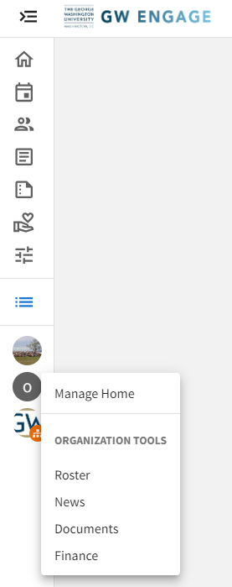
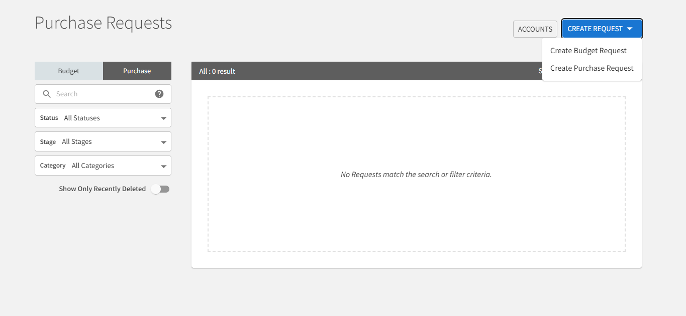
How to put in Purchase Requests? Pt. 1
In Engage, on the left side of the Home Page, select the organization you are submitting the Purchase Request for.
After selecting the organization, select the Finance Option at the bottom of the list
On the Purchase Request page, select the blue Create Request button, then select Create Purchase Request.

Slide 6
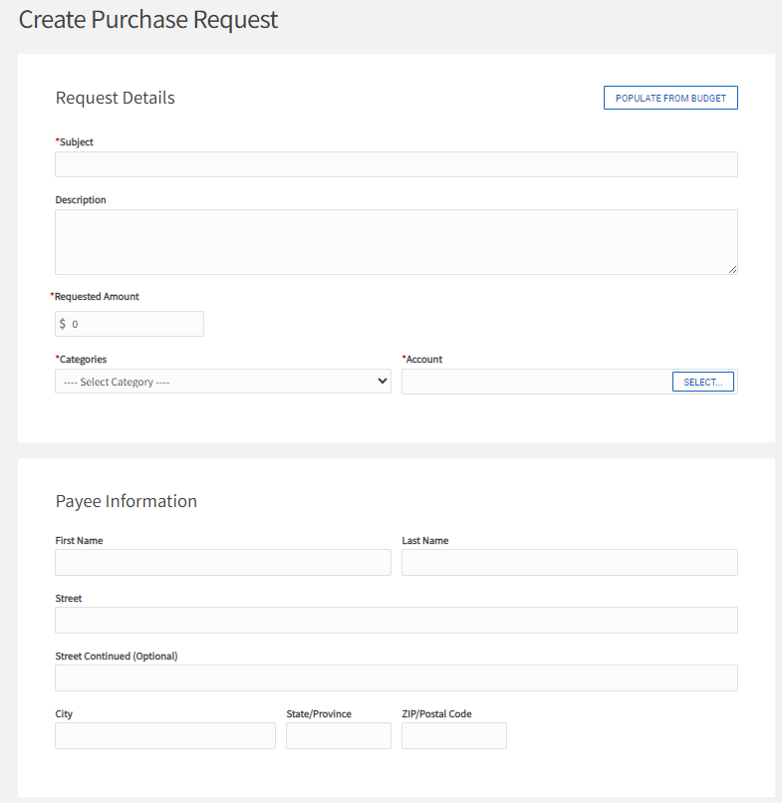
How to put in Purchase Requests? Pt. 2
If you intend to spend from your organizations SGA Budget or Co-Sponsorship, you need to start by selecting the ‘Populate From Budget’ button to select the Budget and the Line item for the Request.
If you are using your revenue, campus rec budget or departmental account, skip this part.
Only one line-item can be selected per request.
Make sure that you select the current Budget or Co-sponsorship.

Slide 7
How to put in Purchase Requests? Pt. 3
Subject
The Subject line in the Purchase Request should be prefaced in the following manner.
Check to Vendor= CHECK:
Credit Card= CC:
Reimbursement= REIMB:
Transfers= XFER:
Enterprise= CAR:
Hotel= HOT:
Travel Tickets= TIX:
Campus Rec Travel= CRT
An example of the Subject line should look like this, PC: Event Supplies. For Request that are submitted from multiple accounts and/or line items, number them in the order you want them allocated from. Ex. CC: Event Venue (1 of 3)

Slide 8
How to put in Purchase Requests? Pt. 3
Description
The following Purchase Request types MUST utilize the Description box to provide the following information. If this information is not provided the request will be denied.
Transfers: Describe why you are transferring funds to the party you intend to
Enterprise: List the drivers and their DOB for the trip
Campus Rec Travel
Enterprise: List drivers, number of cars rented, and type of cars rented
Hotel: Hotel name and number of rooms booked
Travel Tickets: Types of tickets booked, and number of tickets booked
All other Purchase Request types do not require this field to be completed. If you have received a line-item transfer approval from the SGA treasurer, note that in this section.
Requested Amount
This amount should never exceed the amount available in the line item selected or the amount available in the overall account.
Account
If you have selected a line item from your SGA budget make sure to select the account ending with “Budget”, as this is your SGA account.
Payee Information
Payee information is ONLY needed for Reimbursement and Check to Vendor
Reimbursement: The student being reimbursed and their address
Check to Vendor: The address provided on the Contract or invoice

Slide 9
How to put in Purchase Requests? Pt. 4
Google Forms
Complete the appropriate form for the Purchase Request being submitted. The Google form should not be completed until you have submitted the Purchase Request(s) in Engage. This is because you will need the Request ID Number, which is not generated until after the Purchase Request is submitted in Engage.
Please submit one google form for each request.

Slide 10
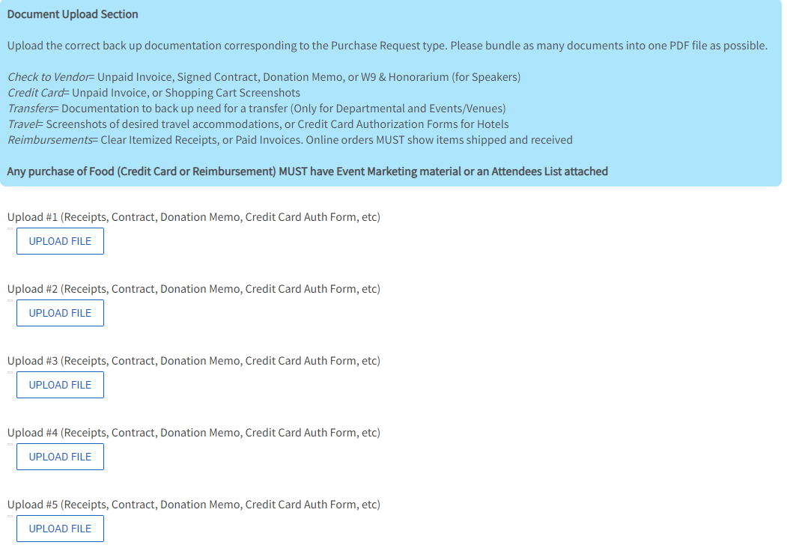
How to put in Purchase Requests? Pt. 5
Document Upload Section – PDF Format
If the proper documentation is not provided the Purchase Request will be denied.
Check= Unpaid Invoice, Signed Contract, Donation Memo, or W9 & Honorarium (for Speakers)
Credit Card= Unpaid Invoice, or Shopping Cart Screenshots
Food Purchases require Event Marketing materials provided upfront
Transfers= Documentation to back up need for a transfer (Only for Departmental and Events/Venues Transfers)
Travel= Screenshots of desired travel accommodations, or Credit Card Authorization Forms for Hotels
Reimbursements= Clear Itemized Receipts, or Paid Invoices
Food Purchases require Event Marketing materials or an Attendees List
Online orders must show items as shipped and received

Slide 11
Most Common Requests
1. Credit Card request:
Most Purchases: supplies, equipment, food, invoices, etc
Amazon: Wishlist Required
Online Subscriptions (Yearly)
Paypal: Invoice required
All purchases must be tax exempt and free of Credit Card Fees
2. Reimbursement:
Emergency Out-of-pocket expenses
Require: Itemized Receipt w/ date of payment & method of payment.
$25-$500
3. Travel:
Hotel: Booking Lodging (NO AirBnB/Vrbo)
Attach Credit Card Authorization Form
Tickets: Transportation (Bus, Plane, Train)
Campus Rec (Anthony Travel)
4. Enterprise:
Rental Car
DCA Most Common Location
Driver Authorization REQUIRED
Must be renewed yearly.

Slide 12
Other Requests
5. Contracts:
Required when a Student Organization is engaging with a vendor/performer and…
Payment is being made for services
The event is on-campus
The event is being recorded/publicly/live streamed
Or a vendor has their own contract required to be signed
Examples
Performers/Entertainers/Speakers/DJ/MC
Catering
Venue Rental
Travel Services (Buses/Hotels)
Types of Contracts
GW Template
Vendor Provided
Combination
Must work with Staff Advisor or Org Help
6. Transfer:
Internal transfer between Student Organizations or GW Department
7. Check:
Check payment to vendor
Vendor must be registered in iSupply

Slide 13
Credit Card Request
The request decision will be returned within 1-2 business days.
Amazon must have a wishlist.
PayPal payments require invoices.
All food purchases require Event Flyer/Attendee List attached
Approved
Status will be moved to “Visit Finance Desk”
The submitter will receive an email with a link to make an appointment to visit our office (in-person or virtually) to complete the purchase.
Denied
Reason for denial will be listed in the request’s comments in Engage.
Before the appointment:
Contact the vendor and make sure that the Sales tax is removed. Information about the Sales tax exemption forms can be found here.
Make sure to have any necessary information ready before the appointment (wishlist, payment method, links, invoices, etc)

Slide 14
Reimbursement
Policies
Itemized receipt REQUIRED showing vendor name, items purchased, purchase total and payment method.
Reimbursement requests should be submitted within 45 days from date of purchase.
Reimbursement amounts ONLY $25 minimum and $500 maximum
No reimbursement for…
Travel expenses (hotel, flights, train, bus, rental car gas).
Registration fees
Cash App/Venmo
Gift cards, prohibited payments , contract payment.
*Exceptions require pre-approval
Process
A member beside the beneficiary should submit the reimbursement request on Engage and Google Form. Attach the itemized receipt and any supporting documents. Please note in description if the beneficiary is a student employee.
The Google Form must be completed with the beneficiary’s information.
The beneficiary should complete the actions required Concur (expense delegates, banking information).
Within one week, our team will provide you with a decision.
Once the request is approved, the money will be directed deposited into the beneficiary’s bank account within 1-2 weeks.
If you receive any Concur notification halting the reimbursement process, please contact our office immediately.

Slide 15
Travel (Hotels and Tickets)
Hotels
Reservations are mainly booked through hotels.com
Student Organizations should put in the Travel request at least 2 weeks prior to the travel date.
If booking directly through the hotel, Students are responsible for contacting the hotel, request the hotel’s credit card authorization form and submit the form to our office.
Be prepared to put a credit card down for incidentals if required by the hotel.
Airfare/Bus/Train
Student Organizations should put in the Travel request at least 2 weeks prior to the travel date.
The University pays for standard baggage fees and economy class only. Any add-ons fees will not be covered by the University.
Camp Rec Travel
All Club Sports Travel should be submitted as Camp Rec Travel (Hotel/Ticket/Enterprise) and will be done through Shorts Travel.

Slide 16
Enterprise
Require University Authorized Drivers.
Submit Travel/Authorization Application at least 10 days in advance.
Authorization Process:
Must be age 20+
Submit Application through staff advisor or Org Help.
Attach copy of driver’s license.
Upon submission, you will receive a drivers test. Certificate of completion must be submitted to Risk
MVR Check
Reservations will not be made until driver authorization is approved
Each authorized driver is approved to drive a maximum of 250 miles at a time. Driving in excess of 500 miles round trip, an overnight stay is required.
Fleet Rentals
Require a Driver’s test in addition to driver authorization approval
Must submit a transfer request.
Email Org Finance with transfer request number to receive oracle number.

Slide 17
Contracts
Student organizations must submit their CIS and have their contract prepared by their advisor or Org Help in order for their event to be approved in Engage.
The Student Organization, with support from their Staff Advisor or Org Help, should work with the vendor to determine the scope of services (date, time, cost), agree upon program format & location (virtual/in-person), and whether the event will be recorded.
The Student Organization must then complete the Contract Information Sheet (CIS), with as much information as possible.
Send the completed CIS form to your org’s assigned Staff Advisor or Org Help and the vendors contract if they have their own.
Upon receipt of the CIS & vendor contract, your Staff Advisor & Org Help will manage the rest of the process, keeping your org CC’d on correspondences with the vendor and on updates.
The CIS is NOT a contract.
If payment is required, the Student Organization must submit an Engage Purchase Request. The contract should be attached to the request. Failure to submit an Engage Request will result in delayed payment

Slide 18
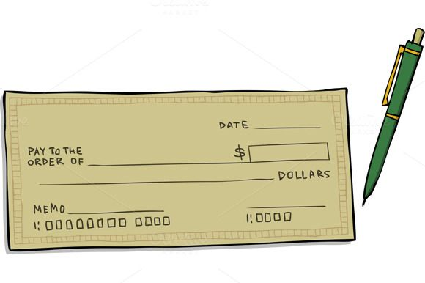
Check To Vendor
Checks can take up to 4-6 weeks from request approval to being paid out.
An invoice must be attached to the request.
Company or individual must be registered with the University through iSupply. Vendors must complete the new vendor registration process.

Slide 19
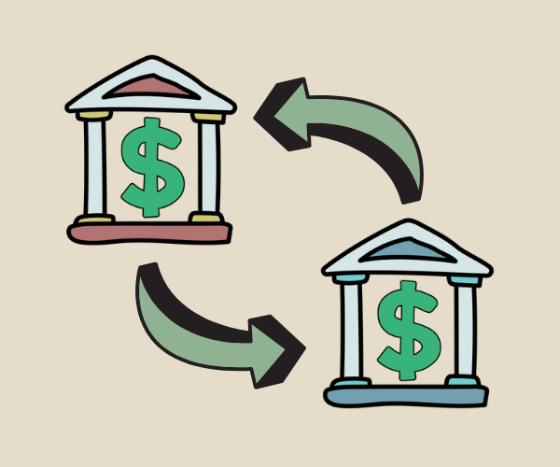
Transfers
Transfer request are used to make a payment to a GW Department or another Student Organization. This is done by submitting a purchase request for a transfer in Engage.
Student Organizations can transfer funds the following ways:
SGA Account to SGA Account
SGA Account to a University Departmental Account
Revenue Account to Revenue Account
Revenue Account to University Departmental Account

Slide 20
Purchase Request Status/Stage Meaning
Unapproved/ Finance Desk Review
Request submitted by Org and placed into the queue for review by the Finance Desk
Denied/ Finance Desk Review
A comment will be left on the request explaining why the request was denied.
Unapproved- Visit Finance Desk
Request approved by the Finance Desk and the student who submitted will receive an email notifying them with instructions to complete the purchase.
Approved- No Action Required
Request approved by the Finance Desk and nothing further is needed from the organization. Amount withdrawn from account.
Approved- Missing Action Item
URGENT; Receipt/Invoice/Event Flyer must be sent to our office IMMEDIATELY or risk of purchase privileges frozen.

Slide 21
Collecting and Depositing Funds
Cash Deposit:
Student Organizations should bring Cash to the Orghelp Finance Office during office hours.
Check Deposits:
All Checks must be made to “The George Washington University” and have the name of the organization written in the memo line.
Student Organizations should bring Physical Checks to the Orghelp Finance Office during office hours.
If checks are mailed, checks can be send to
[STUDENT ORGANIZATION NAME]
800 21st Street NW, Suite 204
Washington, DC 20052
ATTN: Org Finance
Credit Card Deposits:
Credit Card Payments can be made through this portal.
Within 1-2 weeks after the payment. The Excel sheets with the payments will be uploaded to the Document Section of the organization’s Engage portal, in the Online Deposit Sheets.

Slide 22
Things to Remember
Deposits to org revenue accounts can be delivered to our office via cash or check. Checks must be made out to “The George Washington University” with the org name in the memo line.
All food purchases require a event flyer attached or attendee list to purchase request (PR) or they will be denied.
Reason for PR denial is located in the comments.
All Engage PRs require an associated Google Form to be submitted.
All PRs sourced from SA Budget Allocations muse have a line item chosen by selecting “Populate from Budget”
All purchases must have tax exemption taken care of before arriving to you appointment.
Appointments are required for all Travel (Hotel & Ticket)
All questions about budget allocations, category transfers, line items, additional budget funding must be directed to SA Finance.
All purchases require an itemized receipt/invoice after the transaction has been completed and before you leave your appointment. If one is not obtained, all future requests may be put on hold.
Please have all material prepared by the time you come in for your appointment in order to complete the transaction in a timely fashion.
Purchases may be split between budget and revenue accounts and split between line items; a different request will need to be made between the split accounts/line items.
Reimbursements must be submitted by someone other than the person being reimbursed and itemized receipt proof of payment required (No bank statements)
Enterprise Request Drivers must be University Authorized Drivers before reservation can be made.
Avoid Negative Balances

Slide 23
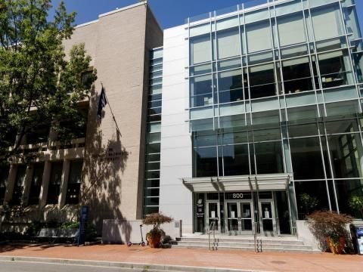
Contact Information
Office Location: Office 433A, University Student Center
Office Hour by appointment: Monday to Friday 12:00 - 5:00pm
Walk-Ins: Friday 1:00 - 3:00 pm (First Come First Serve)
Email : orghelpfinance@gwu.edu
Phone Number: (202) - 994 - 3204
Website: www.studentlife.gwu.edu/org-finances-and-fundraising
Pathways: Student Org Finance Requirement Quiz

